Slide 1
Audit Readiness:
Oversight Testing & Remediation
Presented to:
CAV Symposium – Commercial Vendors
Presented by:
NAVSUP HQ
September 10, 2024

Slide 2
Agenda
Introduction to NAVSUP HQ ‒ SUP 18 Audit Support Department
Existence & Completeness (E&C) Testing
Lessons Learned
READY. RESOURCEFUL. RESPONSIVE.
2

Slide 3
Introduction
3

Slide 4
Our Mission Statement
Provide Naval Supply System Command (NAVSUP) Enterprise planning, stakeholder alignment, coordination, reporting and oversight to optimize Navy Working Capital Fund-Supply Management (NWCF-SM) Inventory Accuracy, audibility, weapon system support, and Fleet readiness.
READY. RESOURCEFUL. RESPONSIVE.
4

Slide 5
Commander’s Intent for SUP18
Intent: The immediate focus is to develop an accurate and transparent financial audit program to improve NAVSUP’s governance and surety of NWCF-SM inventory accountability to achieve Fleet mission requirements
Vision: SUP18 orchestrates, integrates and synchronizes audit responsibilities for NWCF-SM materiel end-to-end, in order to achieve reliable, accurate, and complete financial data for use in key management decisions
Future-State: A world-class financial & inventory accountability program resulting in inventory optimized for NAVSUP’s E2E Supply Chain Operations to realize Fleet readiness and lethality targets
READY. RESOURCEFUL. RESPONSIVE.
5
Notes:
Things to remember: It is not your company being audited, it is the Navy being audited. The training you are about to receive from the CAV Analysts, directly correlates to the accuracy in the reporting of inventory transactions. This has a direct impact in the results of the audits being conducted. The more accurate and timely your activity is in posting these transactions, leads to better results and less of an impact to your operations during an audit.

Slide 6
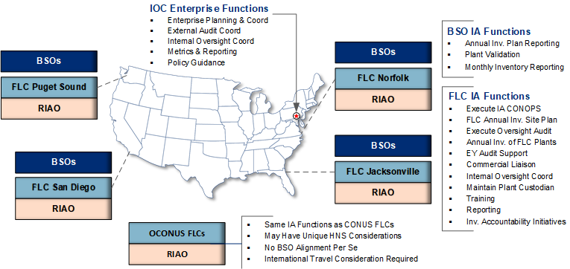
Background
NWCF-SM represents a complex network of inventory that supports Naval Aviation and Maritime readiness. There is approximately $44B of NWCF-SM in over 1,000 warehouses worldwide, split into eight (8) regions. Five regions are in the United States ‒ Norfolk, Jacksonville, San Diego, Puget Sound and Pearl Harbor. The other three regions are located at Sigonella, Italy, Yokosuka, Japan and Bahrain.
READY. RESOURCEFUL. RESPONSIVE.
6
Notes:
We have Regional Inventory Accuracy Officers (RIAOs) assigned in each of these regions to assist SUP18 with testing and remediation functions at the physical locations. RIAOs are available to assist with training, scheduling, testing, and issue resolution upon request.

Slide 7
NAVSUP Audit Campaign Plan (ACP) Phasing
Targeted Completion Date of NWCF-SM Inventory: 2026
Sep ’25
Commercial
755 Plants
PHASE 4
Key Partners
$9.6B
Existence & Completeness (E/C) Testing
Inventory Accuracy
Iron Clad Controls
Mar ’25
DoD Non-Navy (excludes DLA)
21 Plants
PHASE 3
DoD
$2.9B
Jan’24
Navy Non-NAVSUP Enterprise
172 Plants
$7.7B
PHASE 2
Other Navy BSO
Jan ’24
NAVSUP Enterprise
33 Plants
$5.4B
PHASE 1
NAVSUP First
21%
30%
11%
38%
Percent dollar value of NWCF-SM Inventory by Phase
25 DLA plants
Valued at ~$20B not included
Four Phase Campaign Plan - $26B Navy Working Capital Fund – Supply Management
READY. RESOURCEFUL. RESPONSIVE.
*Plant numbers and $ values based on June 30, 2024, COOPER List / ERP data
14

Slide 8
Audit Purpose
Purpose of a DoD Congressional Audit
The financial statement audit provides decision makers with assurance on the reliability of the financial statements, reporting on deficiencies in internal control over financial reporting, reporting on non-compliance with laws and regulations.
Auditor’s Responsibility
Express an opinion (i.e., modified, unmodified) based on tests performed
Summarize and present issues found for management using Notice of Findings and Recommendations (NFR)
Management’s Responsibility
Prepare and present financial statements
Design, implementation and maintenance of internal controls and systems
Retain Key Supporting Documents (KSDs) to support financial events
Remediate NFRs reported through the audit
READY. RESOURCEFUL. RESPONSIVE.
8
Notes:
Audit 101 Training Presentation, which provides further detail and information on the Independent Public Audit (IPA) process can be requested from your WSS N85 CAV Analyst

Slide 9
Audit Assertions & Procedures
Auditors design procedures to gather and evaluate evidence and meet specific audit objectives based on the following assertions:
READY. RESOURCEFUL. RESPONSIVE.
9
Notes:
Existence or occurrence: An entity’s assets (things we own), liabilities (things we owe), and net position exist at a given date.​
Completeness: All transactions and events that should have been recorded are recorded in the proper period.
Accuracy/valuation or allocation: Amounts and other data relating to recorded transactions and events have been recorded appropriately

Slide 10
NAVSUP Audit Campaign Plan Audit Readiness NAVSUP / DCMA Phase IV (Commercial Vendors) Gap Analysis
 | NAVSUP Lines-of-Effort | NAVSUP CAV/SOW | DCMA Audit Objectives
 | Receipt-to-Stow (RTS) Issue (ISS) | Materiel Reporting Receipt/Issue Update CAV/RP within 7 BDs eRMS/NITA Access [every seven (7) days] Proof of Shipment (POS) Proof of Receipt (POR) On-Hand Acknowledgement (OHA) Supply Discrepancy Reports | Contract & Data Standards Compliance
 | Issue (ISS) | Receipt eRMS/NITA Access [every seven (7) days] Proof of Shipment (POS) Proof of Receipt (POR) On-Hand Acknowledgement (OHA) Supply Discrepancy Reports
 |  | eRMS/NITA Access [every seven (7) days] Proof of Shipment (POS) Proof of Receipt (POR) On-Hand Acknowledgement (OHA)
 |  | Proof of Shipment (POS) Proof of Receipt (POR) On-Hand Acknowledgement (OHA)
 | Materiel-In-Repair (MIR) | Record Materiel Condition Codes Update CAV/RP within 7 BDs
 | Disposal (DIS) | Specific disposition instructions for disposal
 | Physical Inventory (PI) | Achieve 99% Inventory Validity Monthly Reporting of Inventory | Asset Accountability
DCMA Guidebook provides detailed government contract property administration requirements … good alignment with NAVSUP CAV-SOW
SECDEF Memo – Expectations on Accelerating DoD Financial Statement Audits; Oct 2023
16

Slide 11
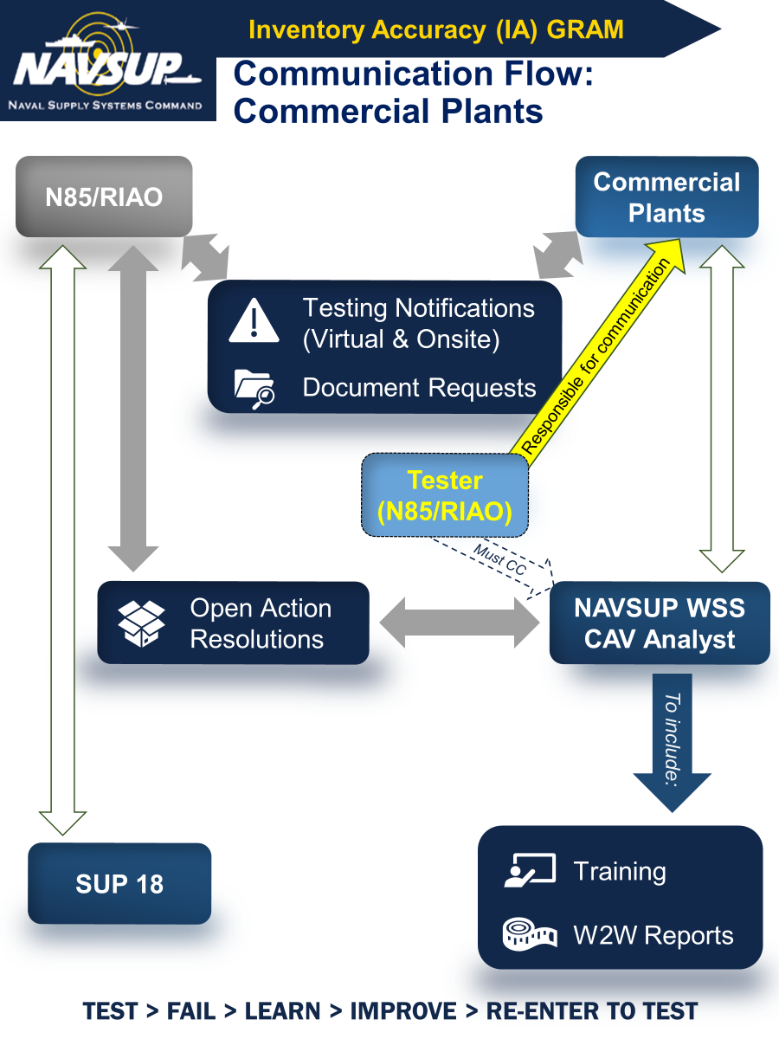
Communication Flow

Slide 12
Existence & Completeness (E&C) and Control Testing
12

Slide 13
Audit / Oversight Testing Expectations – E&C Testing Timeline
E&C Schedule Development
4-5 Weeks prior to Scheduled E&C
2-3 Weeks prior to Scheduled E&C
1 Week prior to Scheduled E&C
Scheduled E&C
7-10 Days after E&C
Plants to be tested are selected
Proposed testing dates identified
AUDIT ONLY – SUP 183 confirms Plant availability to support proposed Audit dates
NAVSUP Site Visit Coordination Team emails Coordination package to BSO/Plant
NAVSUP Testing Teams begin/monitor the Coordination process
BSO/Plant completes and returns Coordination package documents
NAVSUP Coordination or Testing Team Lead establishes communications/schedules one or more meetings with BSO/Plant to confirm all information and arrangements including Security requirements
Existence NIINs selected for testing may be provided to the plant no more than 2 business days prior to the scheduled start date.
at the discretion of the IPA (Audit) or NAVSUP Testing Team (Oversight Testing).
IPA/NAVSUP Testing Team conducts on-site E&C at Plant
IPA/NAVSUP Testing Team facilitates Daily Hot Wash Meetings
IPA/NAVSUP Testing Team facilitates Close-Out Meeting on final day
SUP 18 Communications Officer or WSS CAV Analyst emails results to BSO/Plant
READY. RESOURCEFUL. RESPONSIVE.
13
Notes:
SCHEDULE DEVELOPMENT: SUP 183 identifies the plants to be tested and puts together a schedule of proposed testing dates for each | IPA provides listing of plants and proposed audit dates to SUP 183, SUP 183 confirms the plants’ availability/provides alternate dates if unable to support the initially proposed dates with the IPA
4-5 WEEKS: Coordination email requests completion of Readiness Checklist and Contact Sheet, as well as confirmation of availability of plant to support testing on scheduled dates – plant is also requested/required to provide any additional information/forms that need to be completed by the testing/audit teams related to Security Accesses, Visit Requests, Proprietary Information
2-3 WEEKS: Oversight Testing Team Lead will continue communications with BSO/Plant to confirm all information provided by Plant & to ensure that Security requirements have been completed/processed | AUDITS – SUP 183 holds “pre-planning” meeting with BSO/Plant and Testing Team to confirm all information provided by Plant, verify Security requirements, and obtain any other information pertinent to the IPA and Testing Team’s arrival and access (3 weeks prior to audit); FMO schedules and holds Planning meeting with BSO/Plant, SUP01 Stakeholders, Testing Team, IPA, DODIG, and any other relevant stakeholders – meeting will confirm dates of audit, audit expectations, start and end times for each day of the audit, start times for audit related meetings (In Brief, Hot Wash, Close Out), and determines arrival time for all persons attending the audit to be able to get through Security and obtain necessary visitor badges/passes.
1 WEEK: Oversight – SUP 183 & KPMG audit coaches determine the Existence NIIN selection & provide to the Testing Team; if applicable to the Plant based on BLA, Testing Team Lead will provide list of Existence NIINs to the plant no more than 2 business days prior to the start of testing (purpose of sending advanced list of Existence NIINs is for plant to identify most time efficient path/process within the warehouse spaces for the Testing Team to access and count the associated assets. Advance NIIN lists are not provided so that the plant can perform their own inventory prior to the Testing Team’s arrival to have their books and assets pristine and matching.) | AUDIT: Generally, IPA does not provide the list of Existence NIINs selected for audit in advance of each day of the audit visit. At most, they may provide the list of NIINs to be counted each day sometime during the day/business day immediately prior to the day the NIINs are planned to be counted (however, the email providing the NIINs may not be sent until very late in the day, sometimes after normal working hours).

Slide 14
Audit / Oversight Testing Expectations – On-Site Visit: Other
Walkthroughs (Audit Only)
IPA will identify processes to be walked through during Planning Meeting held two weeks prior to the scheduled visit, if any
Plant shows the IPA and NAVSUP Testing Team how they perform the requested process by live demonstrations
KSDs may be requested by IPA
Training (Oversight Testing Only)
NAVSUP Testing Team provides training/instruction to Plant personnel as required or requested
READY. RESOURCEFUL. RESPONSIVE.
14

Slide 15
Audit / Oversight Testing Expectations – On-Site Visit: E&C Testing
E&C Testing
IPA / NAVSUP Testing Team provides list of Existence NIINs to be counted each day, and requests on-hand inventory balance reports from Plant and NAVSUP
IPA / NAVSUP Testing Team judgmentally selects Completeness NIINs from the plant floor, and requests on-hand inventory balance reports from Plant and NAVSUP
Existence and Completeness NIINs are observed and counted
Key Supporting Documents (KSDs) may be requested by IPA / NAVSUP Testing Team
Requested KSDs are provided by Plant to IPA / NAVSUP Testing Team
READY. RESOURCEFUL. RESPONSIVE.
15

Slide 16
Audit / Oversight Testing Expectations – On-Site Visit: Meetings
In-Brief Meeting
First day of event to introduce all parties, review the plan for the week, and address any questions prior to the start of the audit/testing.
Daily Hot Wash Meetings
Daily reconciliation to ensure tasks are on track and advise of any findings, outstanding actions and adjustments that need to be made for the following day(s).
Close-Out Meeting
Reconciliation on the final day of the event to ensure all parties have the same understanding of what was observed and what may be outstanding.
READY. RESOURCEFUL. RESPONSIVE.
16

Slide 17
Audit / Oversight Testing Expectations – On-Site Visit: Key Supporting Documents (KSDs)
KSD Requirements
Daily, throughout the duration of the E&C testing visit, the auditor/tester will request the plant provide WEBCAV or CAV RP on-hand balance report (Condition Code Count by NIIN) for the NIINs to be tested that day
These reports and on-hand balances will be compared to the Navy-ERP on-hand balance report provided by SUP 183 & the physical inventory counts
Daily, throughout the duration of the E&C testing visit, the auditor/tester will request the plant provide KSDs as warranted to support and/or explain discrepancies noted for NIINs.
Evidence of pending postings ( incoming/outgoing DD1348-1A, induction/completion/disposal reports)
Evidence of material at alternate locations
Key KSD Attributes
Document Number / MILSDOCNR (if applicable)
Asset Description – National Item Identification Number (NIIN), Part Number (if applicable), Serial Number (if applicable), Condition Code of NIIN (A, F, G, M, etc.), and Quantity
Date
Defense Activity Address Code (DoDAAC), Plant Name, or Plant identifiable information of the plant(s) posting transaction(s)
Printed name(s) and Signature(s) – if applicable
READY. RESOURCEFUL. RESPONSIVE.
17

Slide 18
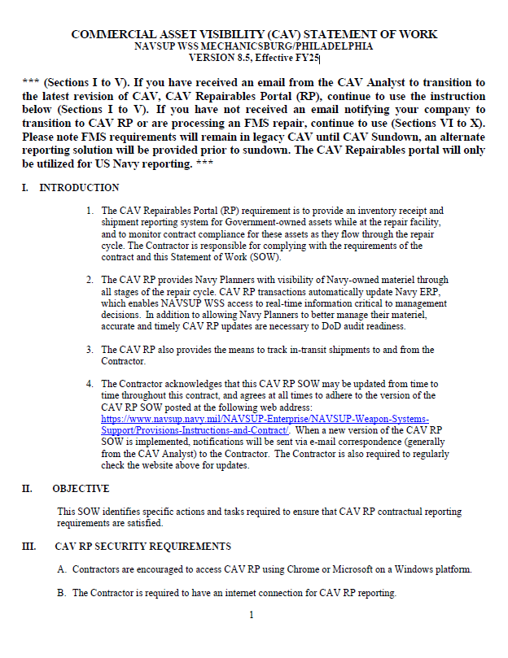
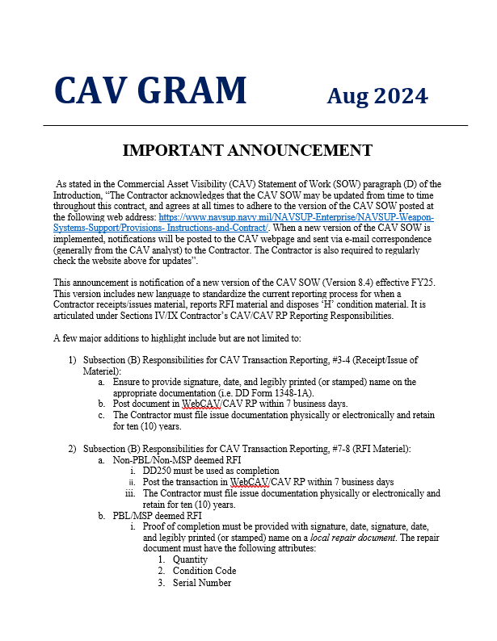
Control Testing – CAV SOW NAVSUP WSS VERSION 8.5, Effective FY25

Slide 19
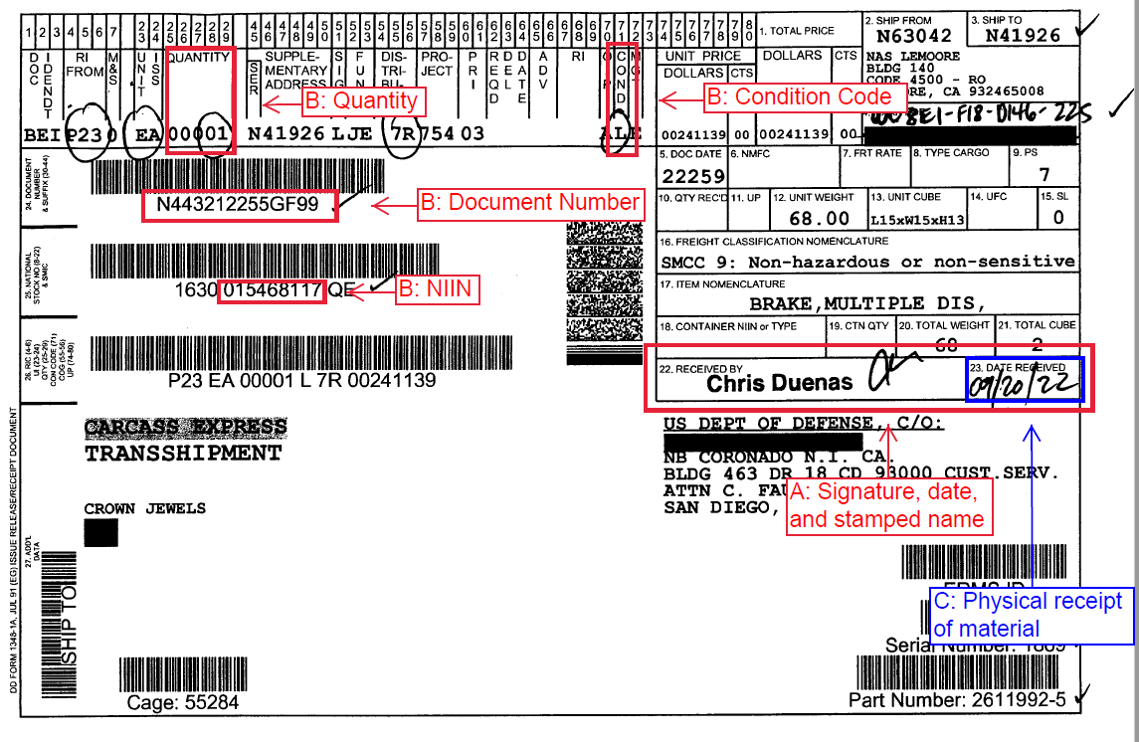
Receipt Business Process Attribute Testing – Section B, 3.j
j) Upon receipt of the materiel described above, the Contractor shall:
Verify NIIN, quantity, document number, serial number (if not present, annotate serial number on document) and condition code of items received by signing, dating, and legibly printing or stamping name on the Shipping/Receipt document.
2) Post the receipt information (NIIN, quantity, document number, serial number, and condition code) reflected on the shipping/receipt document to CAV RP
within seven (7) business days of receipt of materiel.
3) File receipt documentation physically or electronically and retain for ten (10) years.
READY. RESOURCEFUL. RESPONSIVE.
Notes:
Attribute C: Make sure to consider the time zone of the plant that is being tested – ERP posts in the time zone the server is in, not the time zone the plant posting the transaction is in

Slide 20
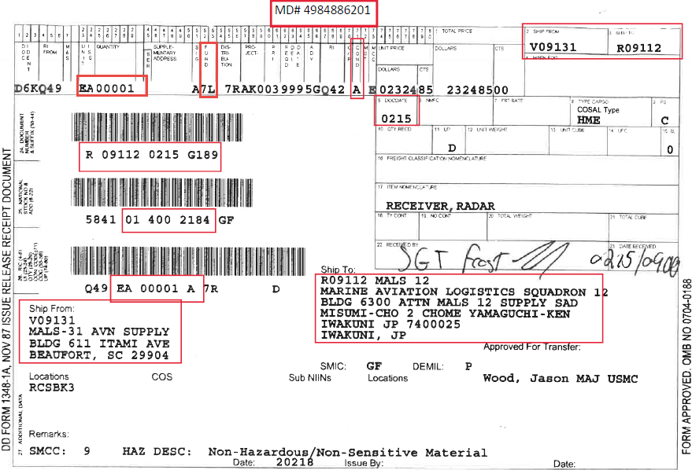
Issue Business Process Attribute Testing – Section B, 4
Obtain delivery agent signature with date, and legibly printed or stamped name
Verify:
A) NIIN
B) Quantity
C) DocNbr
D) Condition Code
E) Serial Number
D7AD7A
The contractor is required to verify NIIN, quantity, document number, serial number attributes of shipping documentation.
Upon pickup by the ATAC carrier, the contractor will obtain the transportation agent’s signature, date, and legibly printed or stamped name on the shipping document if possible. If signature was not obtained, the contractor will annotate the shipping document with date of the custody transfer and reason the transportation Agent’s signature was not received.
Post the issue information (NIIN, quantity, document number, serial number, and condition code) reflected on the shipping/receipt document to CAV RP within seven (7) business days of physical shipment.
File receipt documentation physically or electronically and retain for ten (10) years.
D
C
A
Jack Frost - FEDEX 0215/0900
E
B
OPERATIONAL FORCE UNITS ONLY RECEIPT/STORE RFI AND ARE EXEMPT FROM THE REQUIRMENT TO ANNOTATE CONDITION CODE

Slide 21
Lessons Learned
Accurate and timely reporting is key
Segregation of NAVSUP-owned materiel
Materiel located at alternate locations (sub-vendors and other repair facilities)
Retention of appropriate KSDs
Effective inventory accuracy controls in place
READY. RESOURCEFUL. RESPONSIVE.
21

Slide 22
Key Takeaways
Importance of Audit Readiness/Reliable Financial Statements/Inventory Accuracy:
Providing Support to Navy and Joint Warfighters
Fleet Readiness
Resolving Notices of Findings and Recommendations (NFRs) issued to Navy by the auditors
Meeting Course of Action Plan (CAP) milestones
Reaching our goal for Materiel Weakness Downgrade by FY 2026
Ensuring the public’s trust in the use of US taxpayer dollars
READY. RESOURCEFUL. RESPONSIVE.
22
Notes:
Things to remember: It is not your company being audited, it is the Navy being audited. The training you are about to receive from the CAV Analysts, directly correlates to the accuracy in the reporting of inventory transactions. This has a direct impact in the results of the audits being conducted. The more accurate and timely your activity is in posting these transactions, leads to better results and less of an impact to your operations during an audit.

Slide 23
SUP 18 Points of Contact
NAVSUP Head Quarters, NWCF-SM Inventory Audit Division (SUP 18)
James Chavis, Director: james.t.chavis2.civ@us.navy.mil
SUP 181 Policy & Planning Division
Carol Courtney, Division Director: carol.m.courtney.civ@us.navy.mil
Ilija Marcic, Commercial Lead Liaison Officer (Cml LNO): Ilija.Marcic.civ@us.navy.mil
William “Bill” Tyree, Audit Lead: william.l.tyree2.civ@us.navy.mil
SUP 182 Analysis & Reporting Division
Timothy Gottschalk, Division Director: timothy.j.gottschalk2.civ@us.navy.mil
SUP 183 Testing, Remediation & Audit Division
Francis “Frank” Egan, Division Director: francis.r.egan.civ@us.navy.mil
Marissa Pulaski, Testing & Audit Support Lead: marissa.d.pulaski.civ@us.navy.mil
Eloy Ojeda, Remediation & Causative Research Team (CRT) Lead: eloy.a.Ojeda.civ@us.navy.mil
Chief Daniel Baldaramos, Management Report Controls (MRC) Testing Lead: daniel.l.baldaramos.mil@us.navy.mil
READY. RESOURCEFUL. RESPONSIVE.
23

Slide 24
Back-Up
24

Slide 25
FY24 Commercial Oversight Testing Results
E&C Testing Results – All Exceptions
Inv Accuracy – Range (NIIN)
Inv Accuracy – Depth (Qty)
62.59%
81.32%
Plants:
NIINs Sampled (Range):
NIINs w/Exceptions:
Qty Sampled (Depth):
Qty w/Discrepancies:
47
1.1K
395
20.5K
3.8K
33
READY. RESOURCEFUL. RESPONSIVE.

Slide 26
FY19 – FY24 Audit Campaign Plan
Phase IV - Commercial Testing Results
CAV SOW Standard 99%
Commercial Oversight Testing Results FY19-FY26
Completion Date: FY26
99% Inventory Accuracy
Updated CAV SOW approved & distributed Sep 2024
Demonstrate compliance with CAV SOW policy & close gap to meet standards
Improved evidencing (KSDs) & accurate / timely transaction posting (7 days) required
Stock-in-Transit (SIT) documentation / follow-up actions required
Proper evidencing of materiel in various condition codes required
Continued 100% annual physical wall-to-wall (W2W) inventories required
EY Results | Range | Depth
FY19 | 37.68% | 79.48%
FY21 | 63.80% | 95.65%
FY24 | TBD | TBD
34
Notes:
Comprehensive inventory accountability preparation(s) … Do you have an “actionable plan?”
Appropriate leadership engagement & subject matter expertise on-site
NWCF-SM Inventory segregation, organization and accuracy
Timely receipt, issue of materiel to include WebCAV / CAV-RP updates
Elimination of potential excess materiel in your possession
Ability to demonstrate familiarity with CAV SOW & compliance
Responsiveness to auditors and ability to produce KSDs

